Slide 1
ESSAY PLANNING
BREAK DOWN THE QUESTION
WRITE A THESIS
PLAN YOUR ESSAY POINTS
WRITE YOUR INTRO
WRITE 3 TEEL / PEE/E PARAGRAPHS
CONCLUSION

Slide 2
HAVING A GO AT BREAKING IT DOWN
Explore the ways at least one text you have studied provided you with a new perspective on an old idea or issue.

Slide 3
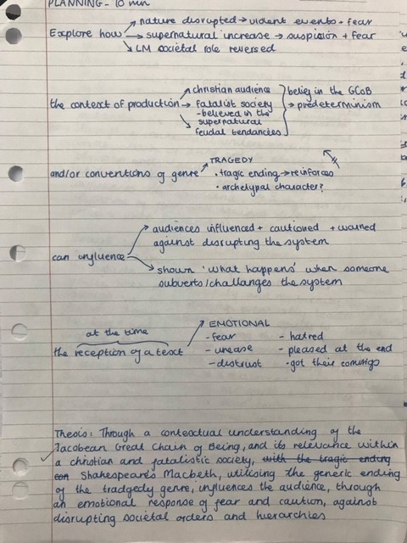
EXPLORING AN ESSAY QUESTION

Slide 4
WRITING AN ESSAY
Start with a clear direction = THESIS
This must include an idea X as Y (WHAT)
And can include the Z HOW – the conventions, language features that construct the idea

Slide 5
WRITING A THESIS
BACK TO BASICS
X AS Y VIA Z

Slide 6
“POLLY PUT THE KETTLE ON”
Polly put the kettle on,
Polly put the kettle on,
Polly put the kettle on,
We’ll all have tea.
Sukey take it off again,
Sukey take it off again,
Sukey take it off again,
The boys have gone away.

Slide 7
HAVE A GO
  This text represents X (abstract, place, group) as Y (adjectives/descriptive phrase)
  via Z (codes/conventions/techniques)

Slide 8
DRAW A CHART AND KEEP ADDING TO IT
X Your focus group, place, person etc. | Y Description of way it’s represented (Can be single word or complex list) |  | Z Codes/conventions/ techniques
Men Women Masculine Feminine Capitalism The domestic sphere Colonial settlements Australian culture Indian culture Western Culture Technology Science Indigenous Australians Immigrants Teenagers Small towns Nature The narrator Patriarchal society The modern world Men and women | Active prizes Dominant Subordinate Confused Chaotic Dangerous Out of control The answer Marginalised victimised Rebellious Ignorant Powerful outsider Privileged Belonging to separate spheres Overwhelming Subservient Rebellious Natural Ignorant Dismissed by men | Violent Passive Outdated Soft Masculine Westernised Saviour Amazing Damaging Innocent Thriving Anxious welcoming Crushed Belonging Surprisingly powerful Objectified Complex Contradictory Heroic Ordinary / everyman Suffocating | Written: Character Setting Narrative point of View Plot / Structure Language features (make separate list) Voices / tone Rhetorical devices Visual: Camera work Editing Lighting Audio Symbols Background/setting People (gaze, expression, costume, stance etc.)

Slide 9
INTRODUCTIONS: 3 PARTS
Part 1 = broad statement relating to main concept or genre in question / creative hook
Part 2 = details about specific texts and context – what, who, when, where
Part 3 = Thesis – What (X as Y) and How (Z)

Slide 10
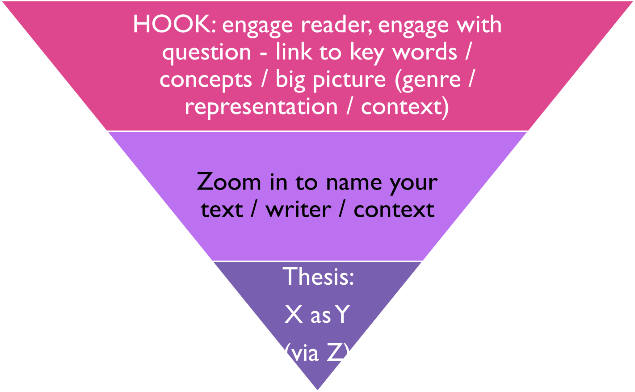
THE INTRO

Slide 11
PARAGRAPH PLANNING
Your body paragraphs would then be framed around the (Y) or (Z)
  The point (topic and supporting sentence) at the start of each paragraph MUST link directly back to the thesis.
  P1= One of the main ways X is represented as Y is through Z1.
  P2 =Another way X is represented as Y is through Z2
  P3 =X is further reinforced as being Y through Z3

Slide 12
VERSIONS OF SAME THING
  OR
  We are invited to see X as Y1 through Z
  On the surface this text may seem to be about a basic plot element, but when you dig deeper it can be read as being about X as Y

Slide 13
PUTTING THE Z FIRST
  In this text the setting (Z) invites us to see X as Y
  The relationship between Z1 and Z2 (two characters or character and setting) encourages the reader to consider the nature of X as Y

Slide 14
COMPARING X AS Y
OR THE WAYS Z WORKS ACROSS TEXTS
In Text 1 X is constructed as Y1 whereas in Text 2 X is constructed as Y2
In Text 1 Z invites us to see X as Y whereas in Text 2 Z invites us to respond to X quite differently seeing it as Y2
Texts 1 and 2 both use Z to position us to question the role of X and see it as Y

Slide 15
INTRO EXAMPLE
IN THE MOST EFFECTIVE TEXTS, GENERIC CONVENTIONS ARE MANIPULATED TO PROVIDE A NEW OR CONTROVERSIAL PERSPECTIVE ON A SUBJECT OR ISSUE. DISCUSS THIS STATEMENT WITH REFERENCE TO AT LEAST ONE TEXT YOU HAVE STUDIED.
Texts that make me think are for me the most effective texts. They take me out of my comfort zone and challenge me to look at an idea in a new way. Yellow Wallpaper, 1892, by Charlotte Perkins Gilman did this for the readers at the time: creating a stir as she plunged her main character into madness. Although challenge to this kind of oppression is no longer controversial, it is still an uncomfortable and, therefore, effective read for modern readers too. Through the manipulation of short story conventions such as the narrative point of view of the victim, the claustrophobic setting and the characterisation of John,(Z) it represents the patriarchal world of 1892 (X) as isolating, infantilising and damaging to women (Y).

Slide 16
PARAGRAPH STRUCTURE
TEEL OR PEE/E
Point: X as Y via Z1
or X as Y1 via Z
  E.g. One of the main ways Text 1 represents X as Y is through Z.
Examples: 3-5 quotes / examples
Explore the words / phrases / visual language in terms of connotations – suggested meanings and likely effect.
Explain/Link: how all of these examples position the audience to see X as Y (link to point) and what is interesting about this i.e. whether they challenge or reinforce dominant ideas / play with usual conventions etc.

Slide 17

SAMPLE PARAGRAPH: YELLOW WALLPAPER
In The Yellow Wallpaper the relationship between husband and wife is used to emphasise the infantilisation of women and how frighteningly powerless the women were at that time. (POINT / TOPIC SENTENCE) The dialogue between the narrator and John constructs the main female character in limited terms using child-like and animal references. (Supporting sentence – intro e.g.1) Although, she is a fully grown woman she is repeatedly described as with such terms as a “blessed little goose” and “little girl”. These suggest she is not only small or child-like in stature but the comparison to a goose also implies she is silly: not to be taken seriously. (connotations) Her acceptance of this infantilisation is probably the most disturbing aspect for a modern audience: (effect)“John laughs at me but one expects that in a marriage.” (e.g. 2)The use of “one accepts that” implies this kind of ridicule was not just in her marriage, but was totally normal in this society. (connotations) This marginalisation of women is reinforced by the way any behaviour or thought by women which falls outside social accepted norms is described in patronising terms like “a slight hysterical tendency” (e.g.3) and thus their concerns as dismissed trivial and not at all rational. The relationship between John and the narrator shows us how the patriarchal society of that time promoted logic over emotions and this was used this to belittle and disempower women.(Link back to point)

Slide 18
CONCLUSION – REVERSE INTRO
Part 1: Reassert thesis
Part 2: Big picture statement – the SO WHAT – why is this idea / representation / use of conventions important or interesting.
  What is being challenged or critiqued or reinforced?
  How does this fit into its textual or social context?
  How does it offer a new perspective on an old idea?

Slide 19
TUCK ME IN
https://www.youtube.com/watch?v=gNQIdEv-Emo&list=PLIr8YTyhDSA2b5d0vlbM1gdAwzWYpeNpA&index=6

Slide 20
HOW DID THIS FILM WORK TO
Convey ideas (about place, people, abstracts)
Affect your response (make you think / feel)
HOW = conventions:
Establish characters (boy / dad); convey ideas about them
Create setting (time and place) and atmosphere
Establish situation / plot structure ( twist = prior knowledge . cultural expectations)
Point of view / perspective – onlooker
= WHAT

Slide 21
IDEAS / THESIS /POINTS
X | Y | Z | Challenge / reinforce / question / critique???
Children Fathers Home Horror Bedtime Night Audience Monsters | Innocent, victims, needing protection, not as innocent as they seem, scary Caring, responsible, protective, not always able to protect Safe place, not always a safe place Hiding in safe places, worse when children or when there’s a twist Safe routine, time for nightmares Scary time, unsafe, safe time of bedtime stories, when we are most vulnerable Scared / horrified, shocked, surprised, expecting the worst Hiding in our homes, in unexpected places, inside us all | Setting: bedroom, home, night time, suburbs, family environment Characterisation: father child Lighting and colour palette: dark, shadowy, blue toned, Camerawork: up at dad, down at kid, CU of kid’s face, slow pan up to bed Audio: silence at end, reassuring casual tone of dialogue Structure: open ending, no resolution, starts with usual bedtime routine – in middle of it (uses prior knowledge) | Challenges Reinforces

Slide 22
QUICK WRITE
Choose group thesis
Write a paragraph in pairs

